Slide 1
Unit 2
Back to school

Slide 2
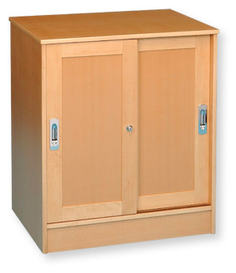
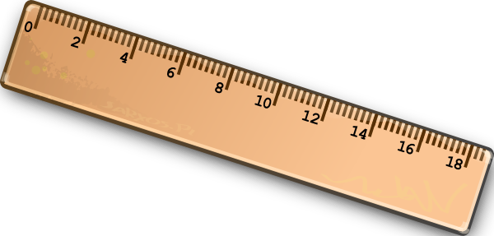
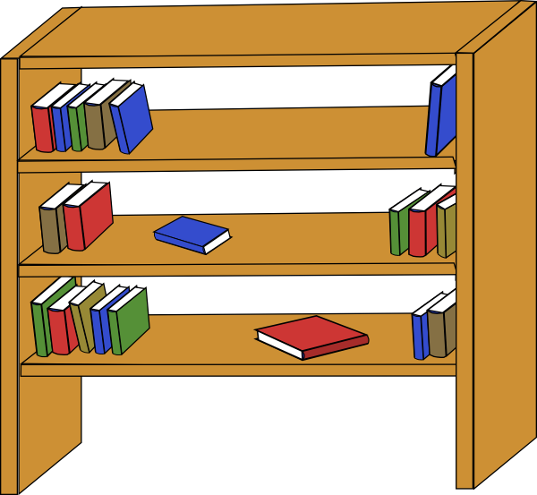
Classroom objects
Cupboard
Ruler
Bookcase

Slide 3

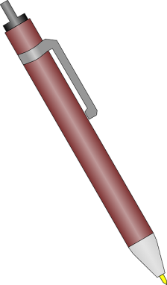
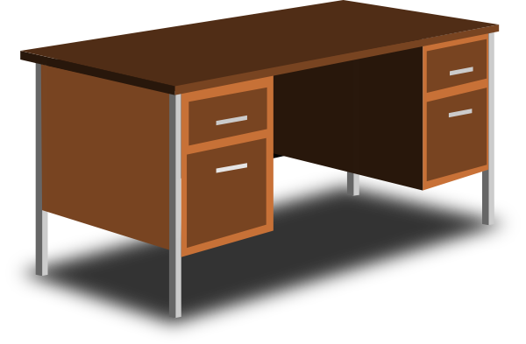

Classroom objects song
Pencil
Pen
Desk
Eraser

Slide 4
Classroom objects song
https://www.youtube.com/watch?v=mTisVqSrfF0
https://www.youtube.com/watch?v=1zJpDVJY6ZY
https://www.youtube.com/watch?v=dsUqBpI3T4k

Slide 5
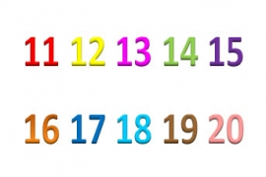
Numbers from 11 to 20
eleven twelve thirteen fourteen fifteen
sixteen seventeen eighteen nineteen twenty

Slide 6
Numbers from 10 to 20 song
https://www.youtube.com/watch?v=wiGEEJLLKd8

Slide 7
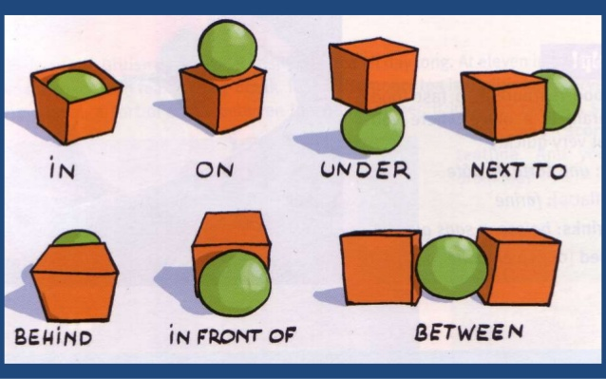
Prepositions

Slide 8
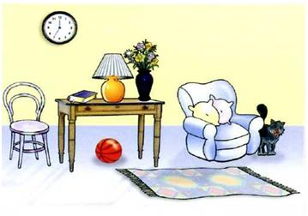
Where is the..?

Slide 9
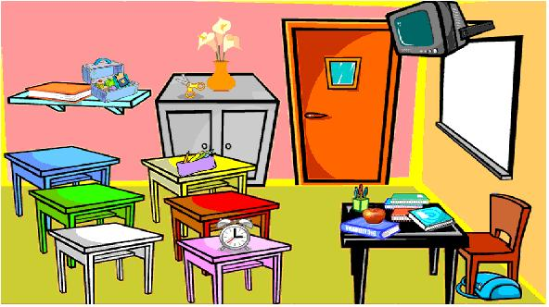
Where is the?

Slide 10
Prepostions song
https://www.youtube.com/watch?v=hx8i-Wq_jtc
https://www.youtube.com/watch?v=0wIIyN8YxyI

Slide 11
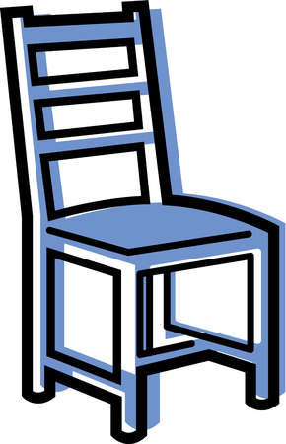
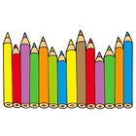
Quantities: there is/ there are
There is: hay un/ hay una
Singular
There’s a chair.
There are: hay unos/ hay unas
Plural
There’re fouteen pencils.

Slide 12
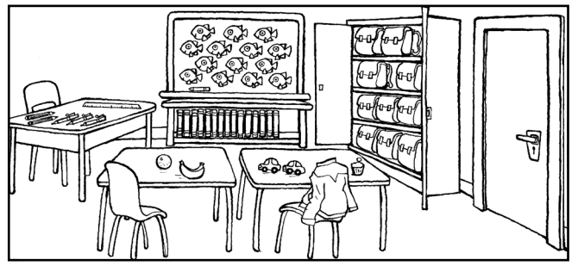
Quantities: there is/ there are

